Slide 1
OBJECT STORAGE
BY AQSA EHSAN

Slide 2
OBJECT STORAGE
Definition:
A storage system that manages data as objects rather than files or disk blocks.
Object = Data + Metadata + Key
Data: The actual content (e.g., image, video, JSON).
Metadata: Descriptive attributes (e.g., content type, owner, custom tags).
Key (ID): A globally unique identifier used to locate and retrieve the object.

Slide 3
Comparison between object , block and file storage
Aspect | Object Storage | Block Storage | File Storage
Data Model | Object = Data + Metadata + Key | Fixed-size blocks (volumes) | Files in folders (hierarchy)
How to Access | HTTP/HTTPS (REST APIs/SDKs) | iSCSI / NVMe / SAN (as a disk) | NFS / SMB (mounted share)
Performance | Higher latency; great throughput for big files | Lowest latency, high IOPS | Medium; good for shared access
Scalability | Massive (petabytes+) | Per-volume/array | Per file server/cluster
Best Use Cases | Images, videos, logs, backups, data lakes, CDN | Databases, VM disks, transactional apps | Team shares, home dirs, app configs
Examples/Tools | Amazon S3, GCS, Azure Blob, MinIO | AWS EBS, on-prem SAN | NFS/SMB, AWS EFS, Azure Files

Slide 4
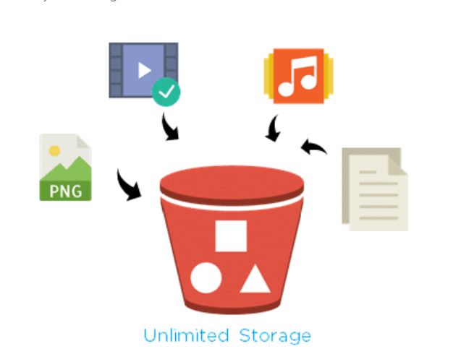
Introduction to S3
Definition:
AWS S3 (Simple Storage Service) is a cloud-based object storage service that lets you store, manage, and retrieve large amounts of data files, images, videos, and backups securely and at scale. It offers high reliability and massive scalability, making data accessible anywhere, anytime over the internet.
Core Concepts:
Store data as objects inside buckets.
Bucket name is globally unique (across all AWS accounts).Region-specific: each bucket lives in a chosen AWS Region.
Object = key–value pair:
Key: the object’s unique name (can include “/” to mimic folders).
Value: the object’s content (the actual file/data).

Slide 5
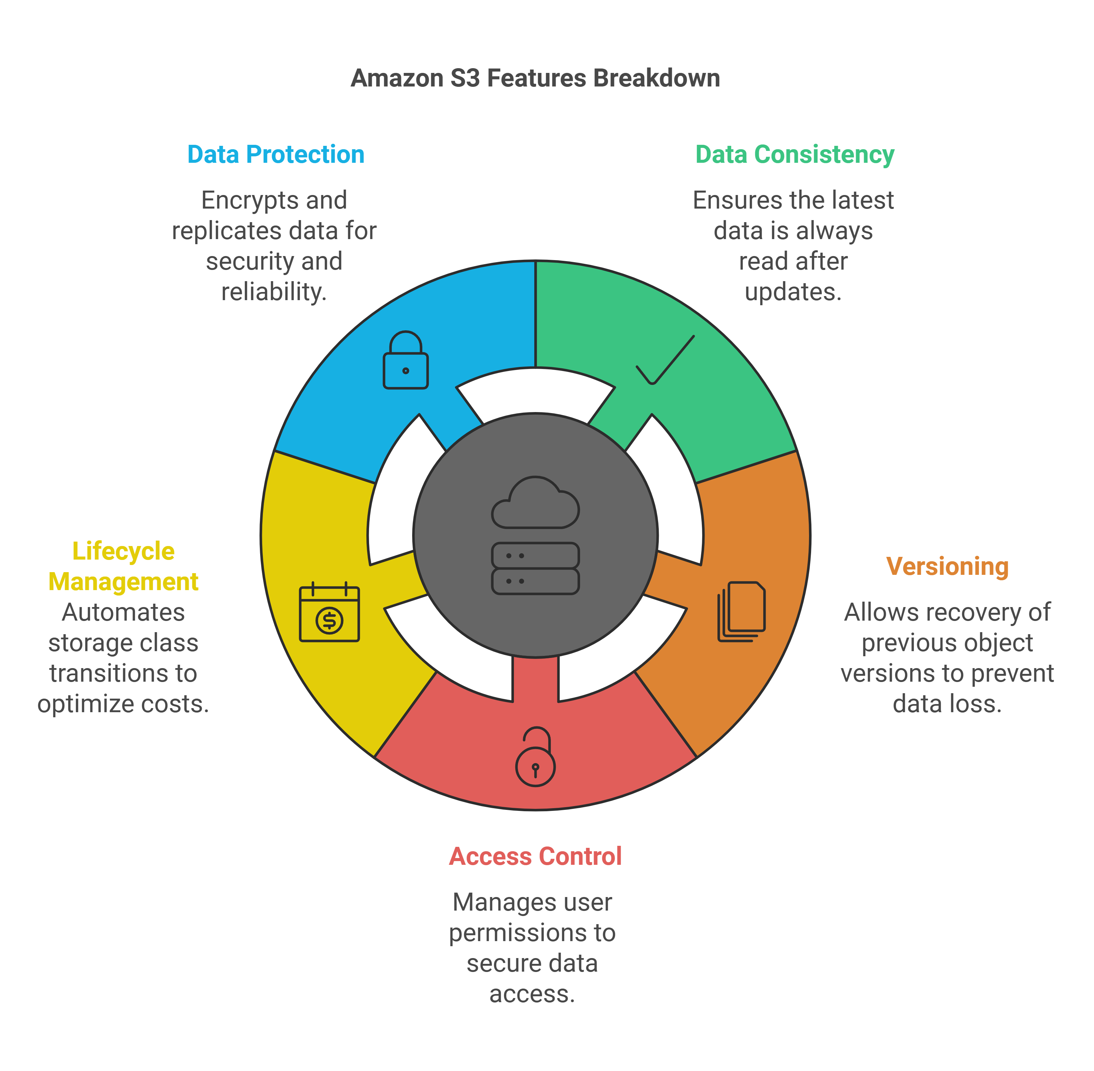
Features of Amazon S3
Data Protection
S3 keeps your data safe and backed up. It can encrypt files and copy them across zones so you don’t lose them. Example: photos are encrypted and still safe if one data center has an issue.
Data Consistency
When you upload or change a file, you see the latest version right away. Example: upload logo.png and a GET shows the new logo immediately.
Lifecycle Management
S3 can auto-move old files to cheaper storage or delete them after some days to save cost. Example: keep logs 30 days in Standard, then move to Glacier.
Versioning
S3 can keep older copies of the same file so you can undo mistakes. Example: if report.pdf is overwritten, restore an older version.
Access Control
You decide who can read or write your files using rules. Example: only your app’s IAM role can read the logs/ folder; public access is blocked.

Slide 6
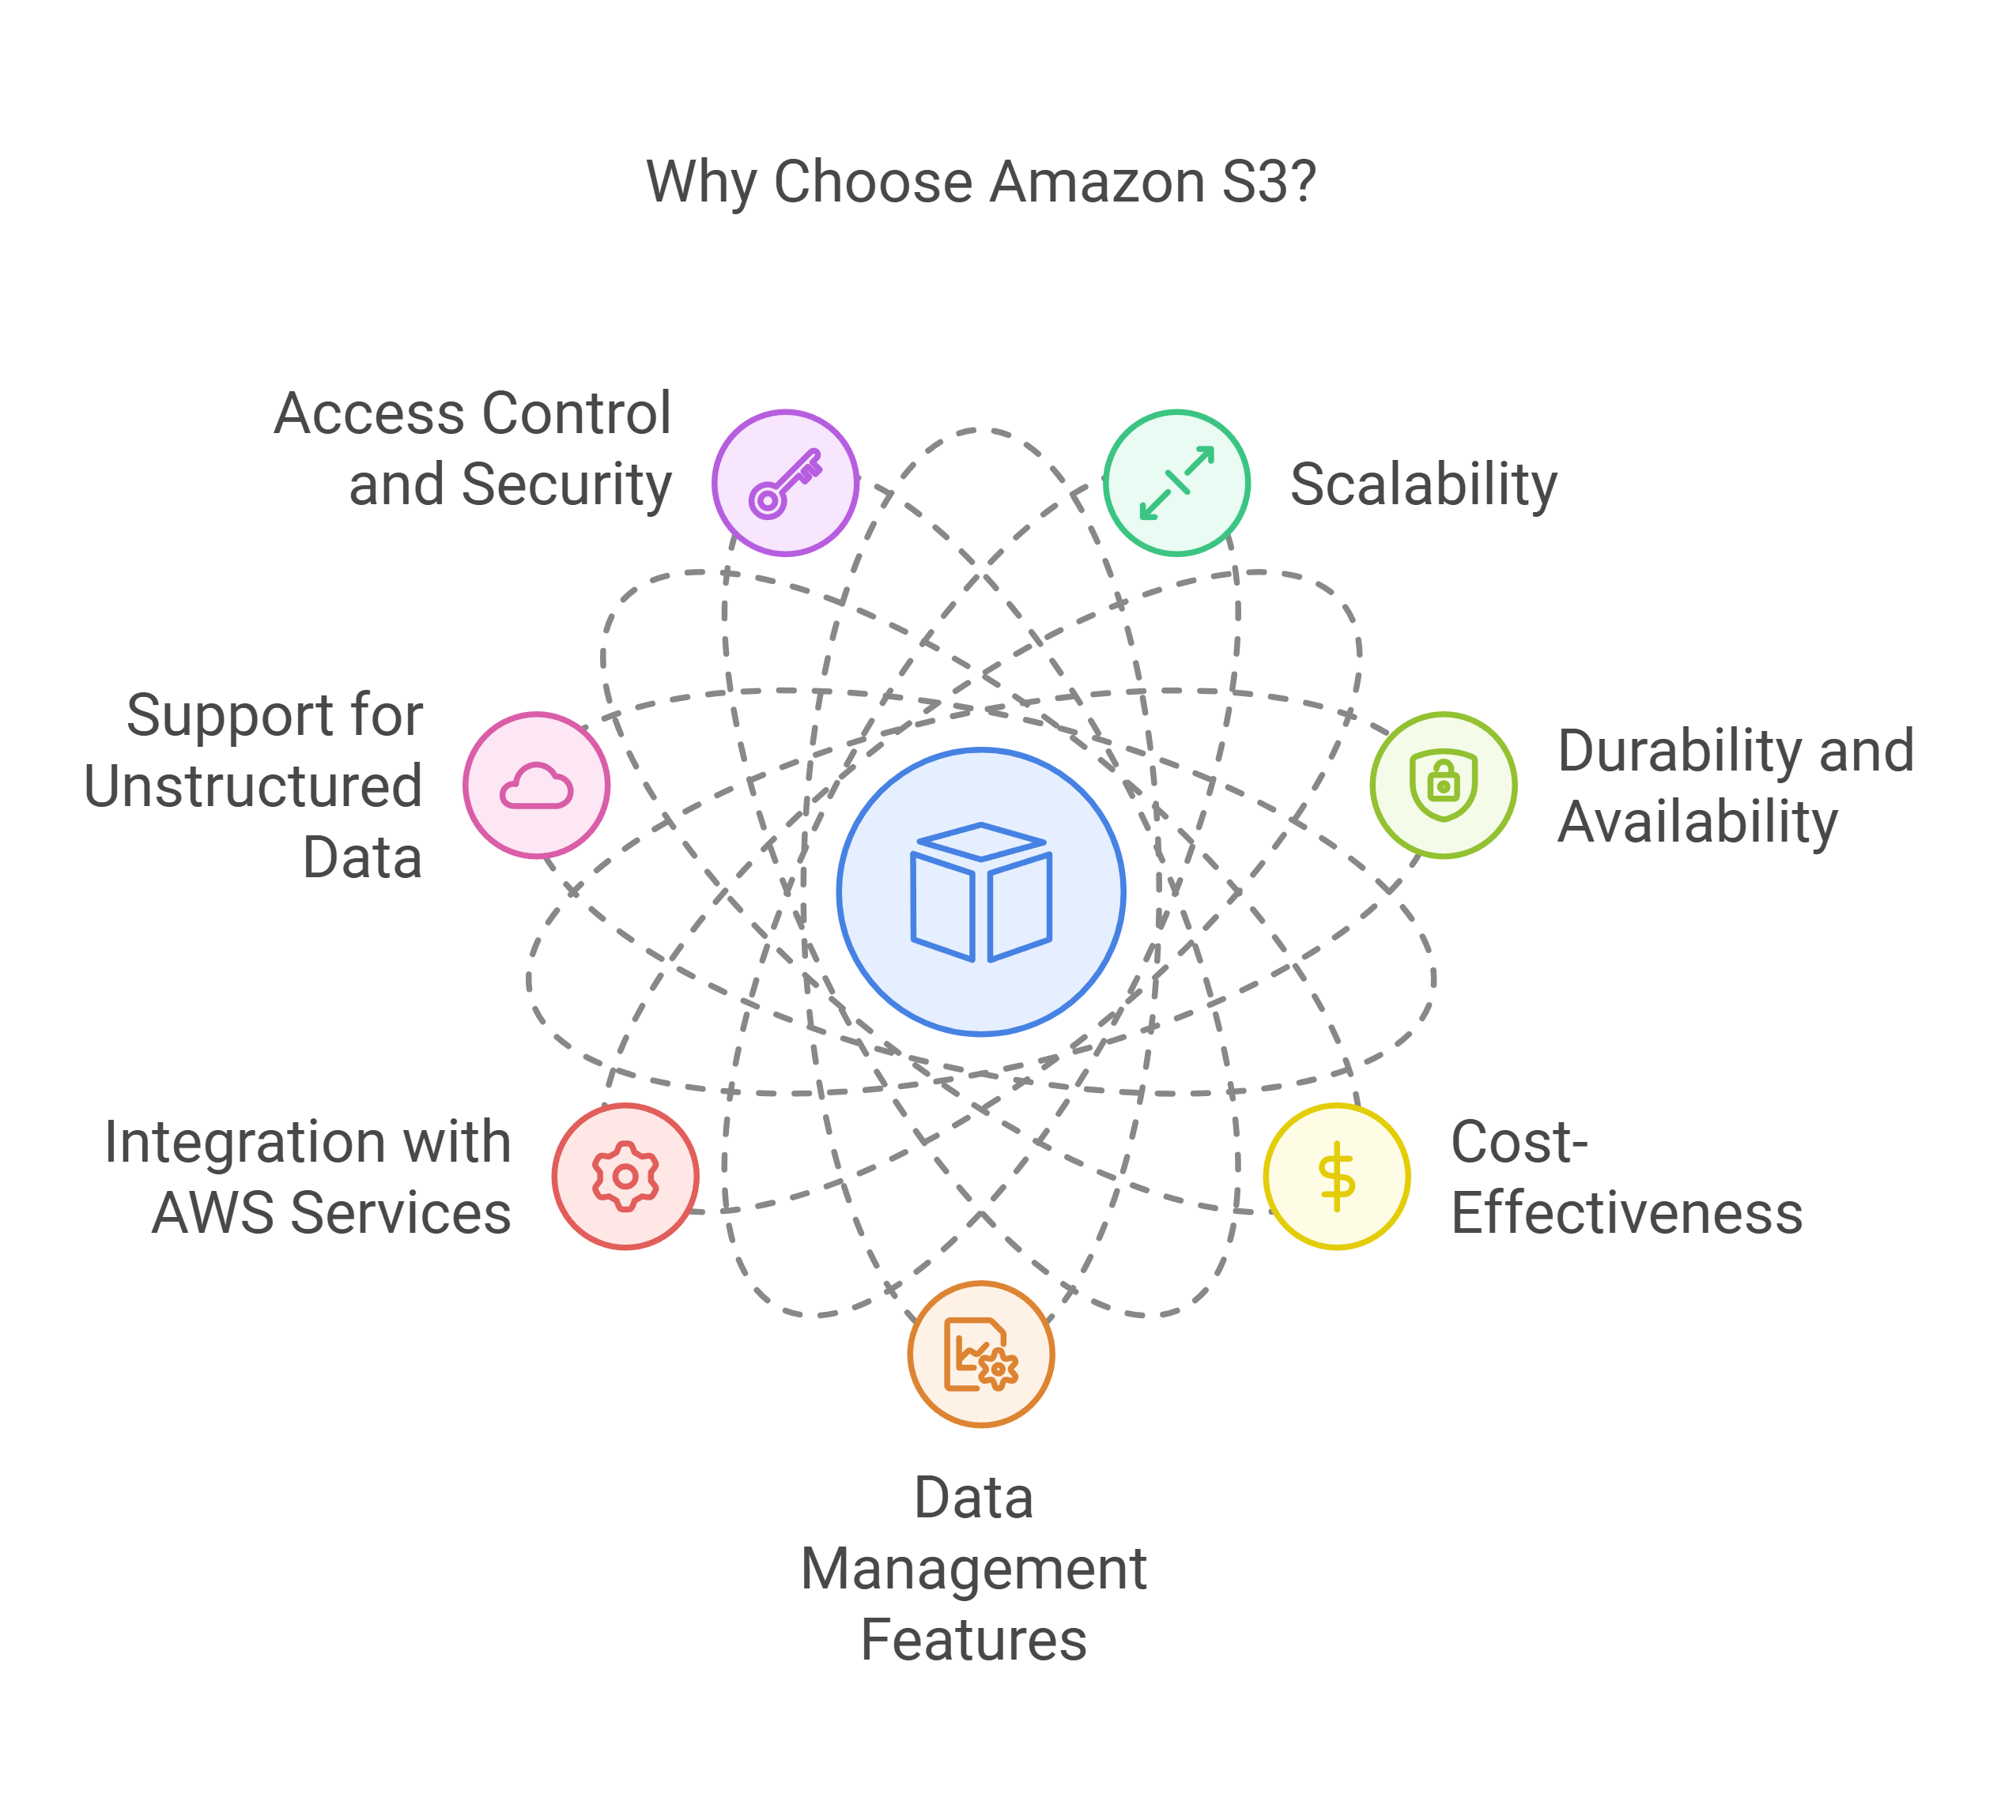
Why to choose S3?
Scalability
starts small and can grow to huge sizes; can handle lots of users and requests at the same time.
Durability and availability
Designed for 99.999999999% durability; data is copied across multiple availability zones in the same region.
Cost-effective
Pay only for what you use; cheaper storage classes for old or rarely used data with lifecycle rules to move or delete automatically.
Data management
Versioning to undo mistakes, lifecycle policies to save cost, replication to another bucket or region, event notifications to trigger actions.
Integration with AWS
Works smoothly with Lambda, Athena, Glue, Redshift, SageMaker, and CloudFront for serverless apps, analytics, ML, and CDN.
Supports unstructured data
Store any file type up to 5 TB (images, videos, logs, backups) and access over the internet via HTTP/HTTPS.
Access control and security
control who can read or write using IAM and bucket policies; block public access by default; data can be encrypted with SSE-S3 or SSE-KMS.

Slide 7
Creating Your First S3 Bucket
Sign in to the AWS Management Console
Open console.aws.amazon.com and log in with your AWS account. Make sure you’re in the right account if you use multiple.
Open Services → S3
In the top menu, choose Services, then select S3 under Storage. You’ll land on the S3 buckets page.
Click Create bucket
This starts the bucket setup wizard where you choose name, region, and options.
Enter a globally unique bucket name
Use only lowercase letters, numbers, and hyphens; no spaces. The name must be unique worldwide (example: my-app-assets-prod).
Choose a Region
Pick the AWS Region closest to your main users or your compute to reduce latency and possibly cost. Data stays in that Region unless you enable replication.
Configure options (optional)
Versioning: keep older copies to recover from mistakes.
Encryption: enable server-side encryption for default at-rest protection.
Tags: add key–value labels like project=website for cost tracking.
If unsure, you can leave defaults and change later.
Set permissions
Keep Block Public Access on to prevent unintended public reads. You can grant access later via IAM roles, bucket policies, or per-object settings.
Review and create
Check name, Region, options, and permissions. Click Create bucket to finish; your bucket appears in the list and is ready for uploads.

Slide 8
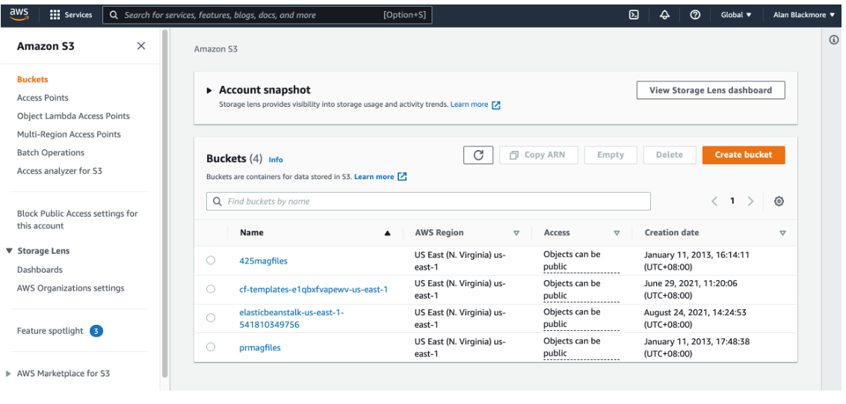
Managing Buckets and Objects via the AWS Console

Slide 9
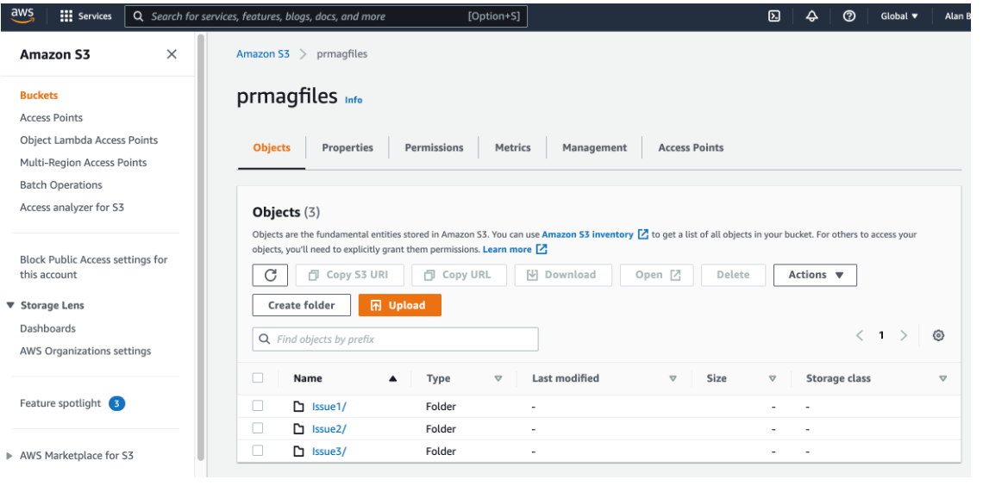
Managing Buckets and Objects via the AWS Console

Slide 10
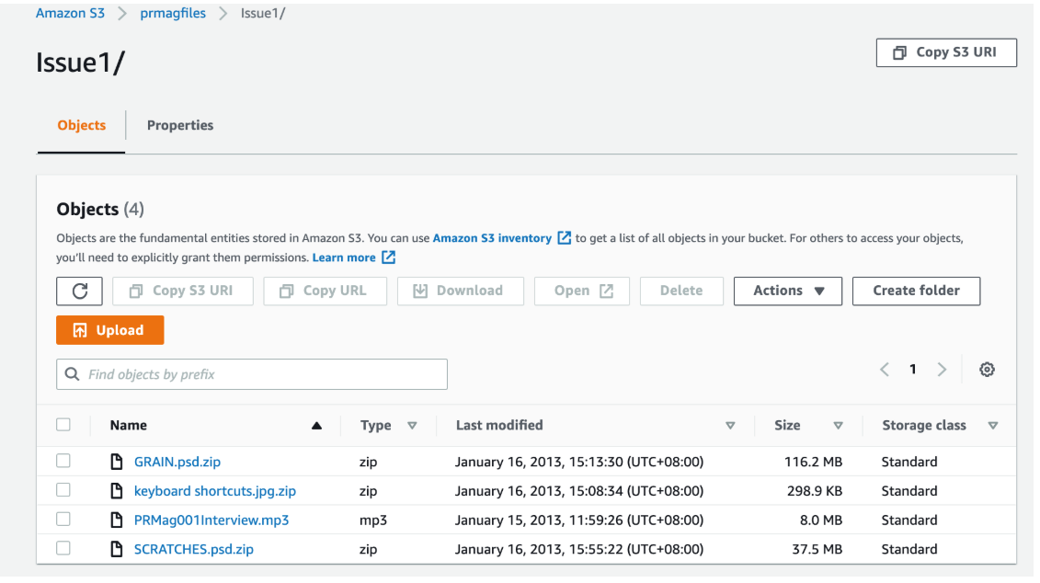
Managing Buckets and Objects via the AWS Console

Slide 11
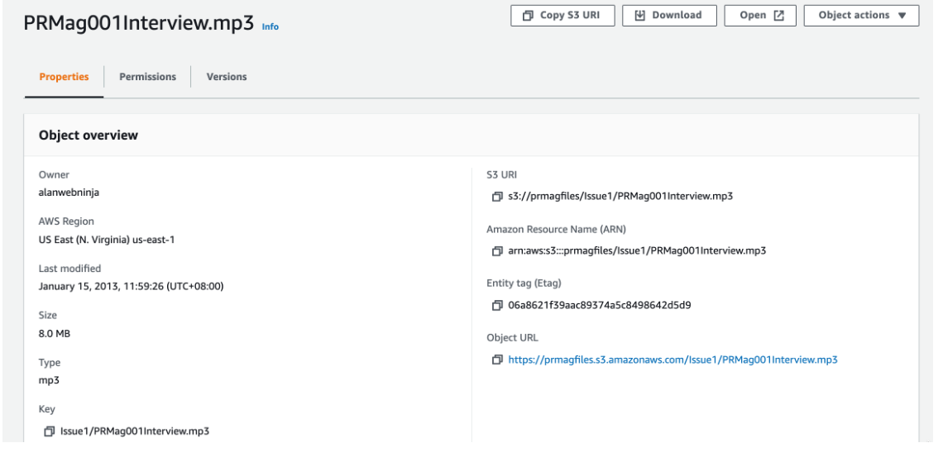
Managing Buckets and Objects via the AWS Console

Slide 12
CRUD in Amazon S3 with Python (boto3)
Setup (assumed once)
Update (overwrite object contents)
import boto3
s3 = boto3.client("s3")
bucket = "my-bucket"
key = "uploads/2025/report.txt"
s3.put_object(Bucket=bucket, Key=key, Body=b"Updated content v2")
Example: replaces the data of s3://my-bucket/uploads/2025/report.txt with “Updated content v2”. If versioning is enabled, this becomes a new version.
Create (upload a local file to S3)
s3.upload_file("report.txt", bucket, key)
Example: uploads local file report.txt to s3://my-bucket/uploads/2025/report.txt.
Delete (remove the object from S3)
s3.delete_object(Bucket=bucket, Key=key)
Read (download an S3 object to local)
Example: deletes s3://my-bucket/uploads/2025/report.txt. If versioning is enabled, it adds a delete marker (older versions remain recoverable).
s3.download_file(bucket, key, "report_downloaded.txt")
Example: saves s3://my-bucket/uploads/2025/report.txt as report_downloaded.txt on your machine.

Slide 13
CASE STUDY USING CRUD OPERATIONS
CASE STUDY
Context. QuickReels is a short-video app where users:
upload an MP4 video (“reel”),
attach a JPG thumbnail,
save some metadata (JSON: caption, tags, duration, etc.),
later stream or download their own video,
sometimes replace the video/thumbnail or delete the reel.
Core storage challenge. We need one place to store many user reels reliably and cheaply, serve them back quickly, and keep everything private-by-default.
Solution: Amazon S3 with:
Key design: reels/<user_id>/<reel_id>/(video.mp4|thumb.jpg|meta.json) Bucket settings:
Versioning Enabled, Encryption AES256, Block Public Access ON Downloads:
via pre-signed GET URLs (time-limited private access) Automation:
Python + boto3

Slide 14
CASE STUDY USING CRUD OPERATIONS
# --- Setup (once) ---
import boto3, json
from botocore.exceptions import ClientError
REGION = "me-pak-1"
BUCKET = "quickreels-pk-aqsa-2025-09-24-8f3a" # change if taken
s3 = boto3.client("s3", aws_access_key_id="YOUR_KEY",
aws_secret_access_key="YOUR_SECRET“,region_name=REGION)
# Create bucket if missing (ignore error if exists)
try:
s3.head_bucket(Bucket=BUCKET)
except ClientError:
s3.create_bucket(Bucket=BUCKET, CreateBucketConfiguration={"LocationConstraint": REGION})
# Safety: versioning + encryption
s3.put_bucket_versioning(Bucket=BUCKET, VersioningConfiguration={"Status": "Enabled"})
s3.put_bucket_encryption(
Bucket=BUCKET,
ServerSideEncryptionConfiguration={"Rules":[{"ApplyServerSideEncryptionByDefault":{"SSEAlgorithm":"AES256"}}]}
)
print("Bucket ready.")

Slide 15
CASE STUDY USING CRUD OPERATIONS
Local file paths from your PC
video_path = r"C:\Users\You\Videos\my_reel.mp4"
thumb_path = r"C:\Users\You\Pictures\my_thumb.jpg"
meta_path = r"C:\Users\You\Documents\my_meta.json"
Define user and reel key ID
USER_ID = "user_987"
REEL_ID = "reel_2025_09_001"
VIDEO_KEY = f"reels/{USER_ID}/{REEL_ID}/video.mp4"
THUMB_KEY = f"reels/{USER_ID}/{REEL_ID}/thumb.jpg"
META_KEY = f"reels/{USER_ID}/{REEL_ID}/meta.json"

Slide 16
CASE STUDY USING CRUD OPERATIONS
Scenario : A user records a new reel and uploads the video.mp4, thumb.jpg, and meta.json from their laptop to S3 under reels/<user_id>/<reel_id>/ in one go.
Create Operation
s3.upload_file("demo_video.mp4", BUCKET, VIDEO_KEY, ExtraArgs={"ContentType":"video/mp4"})
s3.upload_file("demo_thumb.jpg", BUCKET, THUMB_KEY, ExtraArgs={"ContentType":"image/jpeg"})
s3.upload_file("demo_meta.json", BUCKET, META_KEY, ExtraArgs={"ContentType":"application/json"})
print("Uploaded video, thumb, and meta.json")
OUTPUT
Uploaded video, thumb, and meta.json from local files.

Slide 17
CASE STUDY USING CRUD OPERATIONS
Scenario: The user opens their reel page to preview/download the video, so the app lists all objects under reels/<user_id>/<reel_id>/ and generates a 1-hour pre-signed URL for video.mp4.
READ Operation
# 1-hour private download/stream link
url = s3.generate_presigned_url(
"get_object",
Params={"Bucket": BUCKET, "Key": VIDEO_KEY},
ExpiresIn=3600)
print("Download (1 hour):", url)
# List this reel's objects
resp = s3.list_objects_v2(Bucket=BUCKET, Prefix=f"reels/{USER_ID}/{REEL_ID}/")
for obj in resp.get("Contents", []):
print(obj["Key"], obj["Size"], "bytes")
OUTPUT
Download (1 hour): https://quickreels-pk-aqsa-2025-09-24-8f3a.s3.me-south-1.amazonaws.com/reels/user_987/reel_2025_09_001/video.mp4?X-Amz-Algorithm=AWS4-HMAC-SHA256&X-Amz-Credential=...&X-Amz-Date=20250924T110530Z&X-Amz-Expires=3600&X-Amz-SignedHeaders=host&X-Amz-Signature=...
reels/user_987/reel_2025_09_001/video.mp4 80128 bytes
reels/user_987/reel_2025_09_001/thumb.jpg 12034 bytes
reels/user_987/reel_2025_09_001/meta.json 214 bytes

Slide 18
CASE STUDY USING CRUD OPERATIONS
Scenario : The user changes the caption and adds a new tag in my_meta.json, then the app re-uploads it to reels/<user_id>/<reel_id>/meta.json to reflect the updated details.
UPDATE Operation
s3.upload_file(meta_path, BUCKET, META_KEY, ExtraArgs={"ContentType":"application/json"})
print("meta.json updated.")
OUTPUT
meta.json updated.
Scenario : The user replaces their reel with a higher-quality my_reel_v2.mp4, so the app re-uploads it to the same key reels/<user_id>/<reel_id>/video.mp4 (versioning keeps the old copy).
UPDATE Operation
better_video_path = r"C:\Users\You\Videos\my_reel_v2.mp4"
s3.upload_file(better_video_path, BUCKET, VIDEO_KEY, ExtraArgs={"ContentType":"video/mp4"})
print("Video updated (new version).")
OUTPUT
Video updated (new version).

Slide 19
CASE STUDY USING CRUD OPERATIONS
Scenario : The user decides to remove a reel, so the app deletes all three objects—video.mp4, thumb.jpg, and meta.json—under reels/<user_id>/<reel_id>/. Because bucket versioning is ON, S3 adds delete markers instead of permanently erasing the data, so if it was a mistake, support can restore a previous version of any file later.
DELETE Operation
for k in [VIDEO_KEY, THUMB_KEY, META_KEY]:
s3.delete_object(Bucket=BUCKET, Key=k)
print("Reel deleted (delete markers added).")
# Show it’s gone unless using a specific version
from botocore.exceptions import ClientError
try:
s3.head_object(Bucket=BUCKET, Key=VIDEO_KEY)
except ClientError as e:
print("HEAD after delete:", e.response["Error"]["Code"]) # should be 404
OUTPUT
Reel deleted (delete markers added).
HEAD after delete: 404

Slide 20
Key Takeaways
Object storage organizes data as objects (data + metadata + key), unlike file or block storage.
Amazon S3 provides high durability (11 nines), scalability, encryption, and access control.
CRUD operations (upload, download, update, delete) can be done easily using Python (boto3).
Real-world case study (QuickReels app) shows how S3 supports video upload, secure access, versioning, and recovery.
S3 integrates with other AWS services for analytics, machine learning, and media delivery.

Slide 21
ANY QUESTIONS ?

